Slide 1



SOTitle: A Transformer-based Post Title Generation Approach for Stack Overflow
SANER 2022
Honolulu, Hawaii, USA
Ke Liu, Guang Yang, Xiang Chen, Chi Yu
Notes:
Hi, I’m Liu Ke, a master’s student from NanTong University. My supervisor is Professor Chen Xiang. I am excited to present our recent work on post title generation for Stack Overflow.

Slide 2

Background
Programming Q&A sites are growing rapidly
100+ million
monthly visitors to Stack Overflow & Stack Exchange
5,000+
Stack Overflow for Teams instances active every day
179% ROI
from companies using Stack Overflow for Teams
45.1+ billion
Times a developer got help since 2008
Notes:
On Stack Overflow, developers can post their problems and wait for other community members to give corresponding answers to their problems. When developers encounter similar problems, such problems and corresponding answers are valuable and can be reused. Until now, millions of developers use Stack Overflow to search for high-quality answers for their programming problems.
While the number of question posts in Stack Overflow has been growing rapidly, there are still a large number of problems, which have not received high-quality answers. These problems may be unclear, unspecific, difficult to understand, or unattractive to related developers.

Slide 3
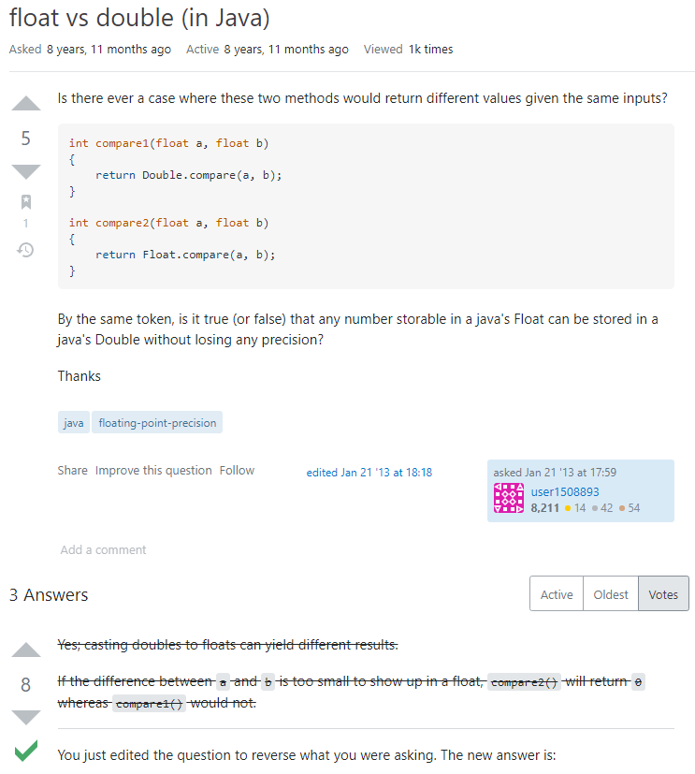
Background
Title
Code
Describe
Score
Tag
Have accepted answer
Notes:
As shown in the picture, a question post in Stack Overflow consists of a title, question description, code snippet, tags, score, accepted answers, etc.

Slide 4
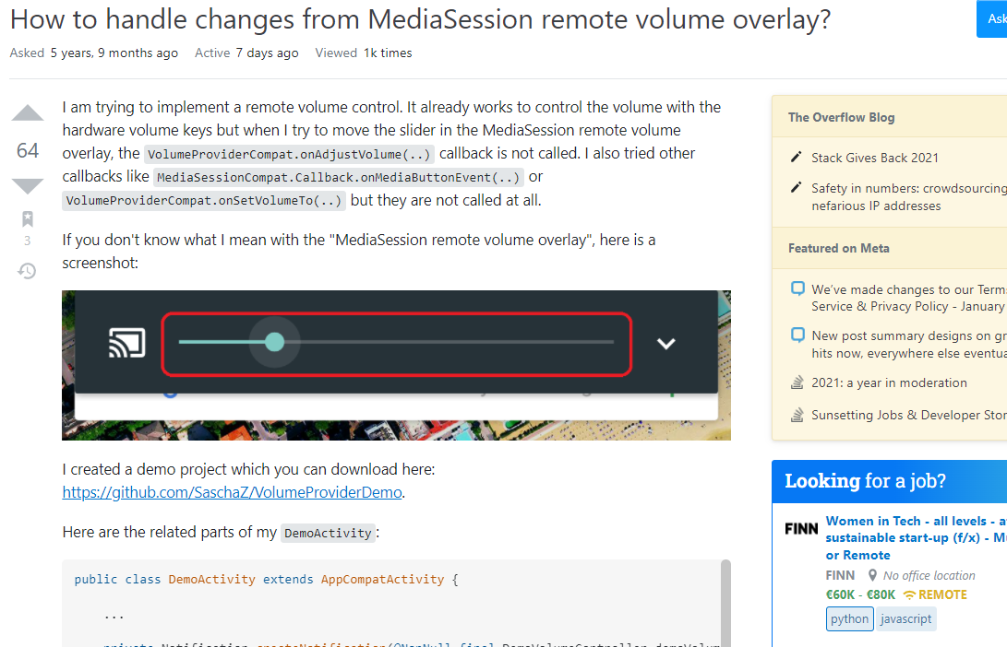
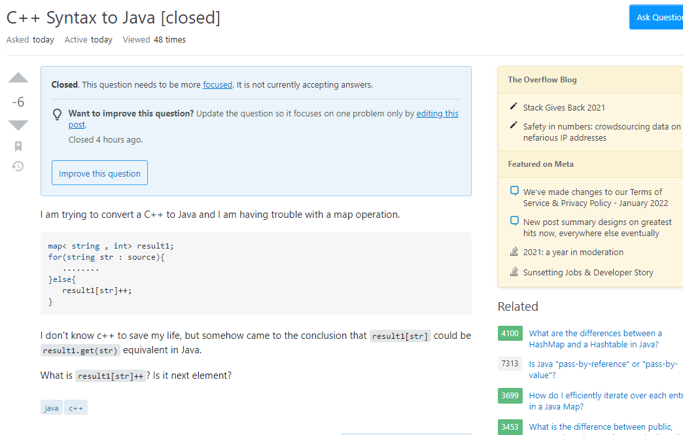
Motivation
One of the important reasons for low-quality question posts is that developers do not create an informative post title
Notes:
some studies found that an important reason for low-quality question posts is that developers do not create informative post title. Some developers may lack knowledge related to their problems, or they may have poor presentation ability. For these developers, writing high-quality problem titles is a challenging task. Therefore, automatically generating post titles for Stack Overflow is needed.

Slide 5

Motivation
Code Snippet(Python):
def get_client_ip(request):
x_forwarded_for = request.META.get('HTTP_X_FORWARDED_FOR')
if x_forwarded_for:
ip = x_forwarded_for.split(',')[0]
else:
ip = request.META.get('REMOTE_ADDR')
return ip
Problem Description (Python) 2:
i tried to get the "real" user ip address, it's working, but i'm not getting my own ip (the real one), checking the ip with google map, after convert it to long - lat, google map is showing the location of my ISP.
Title 2:
How get the "real" user ip address?
URL 2: https://stackoverflow.com/questions/13076259/
problem description of the post can provide valuable information
Problem Description (Python) 1:
I have a Custom User model that takes user ip address. I want to add the IP address of the user upon completion of the sign up form. Where do I implement the below code? I am not sure whether to put this into my forms.py or views.py file.
Title 1:
Where in my django app do I implement this get_client_ip() function?
URL 1: https://stackoverflow.com/questions/57107116/
Notes:
To our best knowledge, Gao et al. were the first to automatically generate a post title according to a specific code snippet. However, they ignored the valuable information in the corresponding problem description. As shown in the figure, there are two posts in Stack Overflow, which have the same code snippet. However, these two posts have different problem descriptions, which result in different post titles. According to this example, we can find the problem description of the post can provide valuable information, which sometimes cannot be provided by the code snippet for title generation. Therefore, considering both modalities (i.e., code snippet and problem description) as the input can help generate high-quality post titles.

Slide 6






Approach
Phase1: Corpus Construction
Phase2: Model Construction
Phase3: Application
Target Java Title
Target Python Title
Generated Title
Target C# Title
Target JS Title
Filter
Rule 1:
Score ≥ 5
Rule 2:
Accepted Answer
Rule 3:
Contains snippets of code
Transformer-based
Autoregressive Decoder
Pretrained T5 model
Extract
Transformer-based
Bidirectional Encoder
Desc
Code
Title
Input Text
C#: Input Text
JS: Input Text
Code
Desc
Corpus
Java: Input Text
Python: Input Text
Notes:
The overall framework of our approach is shown in the slide. In this slide, we can find that SOTitle consists of three phases (i.e., corpus construction, model construction, and model application).
In particular, (1)in the corpus construction phase, we design three heuristic rules to collect high-quality question posts from Stack Overflow. In our constructed corpus, we mainly focus on posts related to four programming languages and extract the code snippet, the problem description, and the title as a triplet from each post.
(2)In the model construction, we first model the multi-modal input by concatenating the code snippet and the problem description. Then we use the SentencePiece method to split these two modalities to alleviate the OOV problem. Later we formalize question post title generation for each programming language as separate but related tasks and resort to multi-task learning, which can allow related tasks to improve each other’s performance by using shared and complementary information. Finally, our model is fine-tuned based on a pre-trained Transformer model T5.
(3)In the model application phase, for a new question post, we input its code snippet and problem description to the constructed model. Then the trained model can automatically generate the corresponding post title through the beam search algorithm.
More details can be found in the paper

Slide 7
Dataset
Filter
Rule 1:
Score ≥ 5
Rule 2:
Accepted Answer
Rule 3:
Contains snippets of code
STATISTICAL INFORMATION OF CORPUS SPLIT RESULTS
Corpus | Training | Validation | Test
Java | 60,000 | 3,959 | 5,000
C# | 60,000 | 6,817 | 5,000
Python | 60,000 | 7,742 | 5,000
JavaScript | 60,000 | 5,780 | 5,000
Extract
Desc
Code
Title
Corpus
Notes:
In this study, we mainly select question posts for four popular programming languages (i.e., Java, C#, Python, and JavaScript). Specifically, we first use Java, C#, Python, and JavaScript tags to collect related question posts. To improve the quality of the gathered question posts, we propose three heuristic rules based on our manual analysis and suggestions from previous studies.
{Rule 1:} The score of the question posts is not smaller than 5.
{Rule 2:} The question posts should have the accepted answers.
{Rule 3:} The question posts should contain the code snippets.
Finally, there are 68k posts for Java, 71k posts for C#, 72kposts for Python, and 70k posts for JavaScript. Then we randomly selected 60k posts as the training set, 5k posts as the testing set, and the remaining posts as the validation set for each programming language.

Slide 8
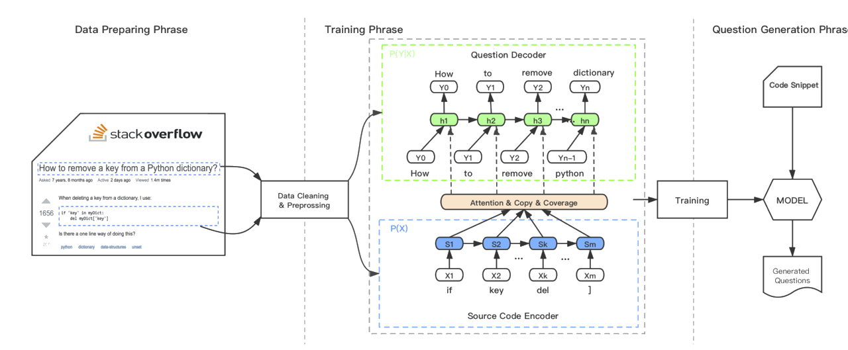
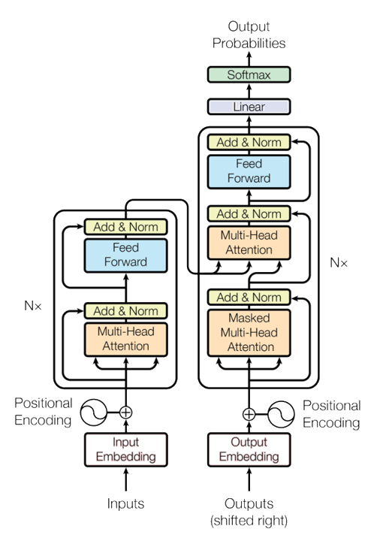
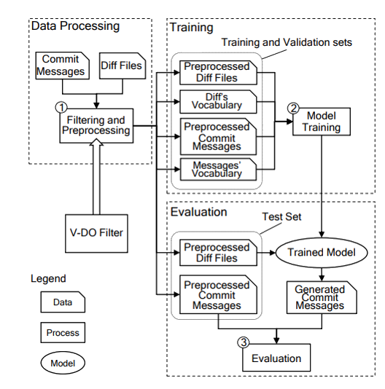
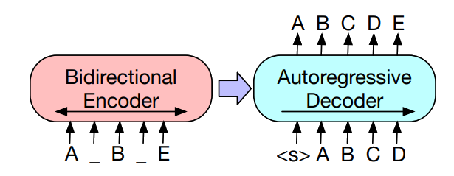
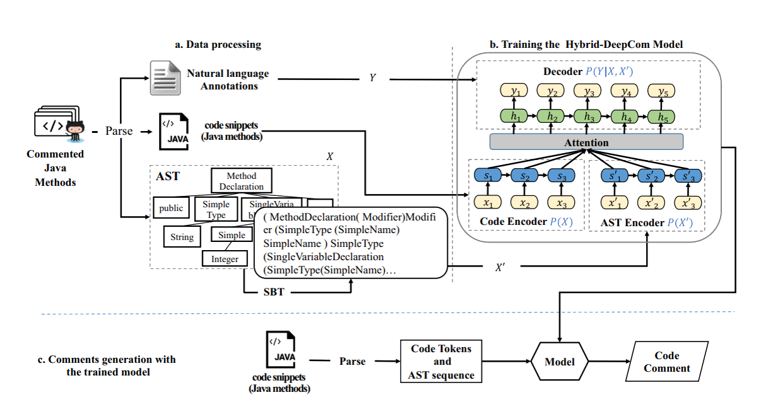
Evaluation-Baselines
BM25
Code2Que
BM25
Transformer
BART
NMT
Hybrid-DeepCom
Notes:
We select six state-of-the-art baselines to show the effectiveness of our proposed approach.
We first select a recent post title generation approach Code2Que as the first baselines.
Then we select three baselines from the text summarization domain. BM25、Transformer、BART
Finally, we select two baselines from source code summarization. NMT、Hybrid-DeepCom
To make a fair comparison, we slightly adapted these baselines to deal with two modalities. In particular, for the baseline Hybrid-DeepCom
, we feed the two modalities into two encoders separately according to their original approach description. For the remaining baselines, we concatenate the code snippet and the problem description together and then feed them into one encoder.

Slide 9



Research Questions
RQ1: Performance
Research Questions
RQ2: Different input modalities
RQ3: Human study
Notes:
In our empirical study, we want to answer the following three research problems (RQs):
RQ1: Can our proposed approach SOTitle outperform state-of-the-art baselines via automatic evaluation?
RQ2: What are the contribution of different input modalities for the performance of SOTitle？
RQ3: Can our proposed approach SOTitle outperform the state-of-the-art post title generation approach CodeQue via human study?

Slide 10
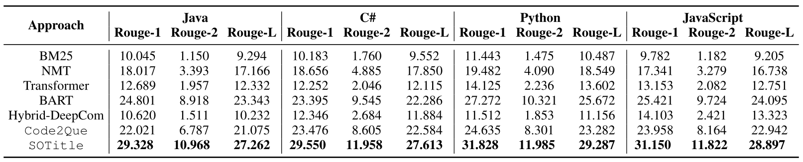
RQ1:Performance
Summary: SOTitle can achieve better performance than six state-of-the-art baselines for different programming languages via automatic evaluation.
Notes:
The comparison results between our proposed approach SOTitle and baselines can be found in the table.
It can be found that our proposed approach SOTitle can significantly outperform six baselines in terms of the performance measure Rouge for different programming languages.
In particular, for our considered baselines, we find deep learning-based baselines (i.e., NMT, Hybrid-DeepCom, Code2Que, Transformer, BART, SOTitle ) can achieve better performance than information retrieval-based baseline (i.e., BM).
In terms of Rouge performance measures, our approach can significantly outperform the post title generation baseline Code2Que. For example, in terms of Rouge-L, compared to Code2Que, SOTitle can improve the performance by 6%,for Java. The potential reason is that we consider the post title generation problem for different programming languages as different but related tasks, which can improve each other's performance by sharing information and complementing each other.

Slide 11
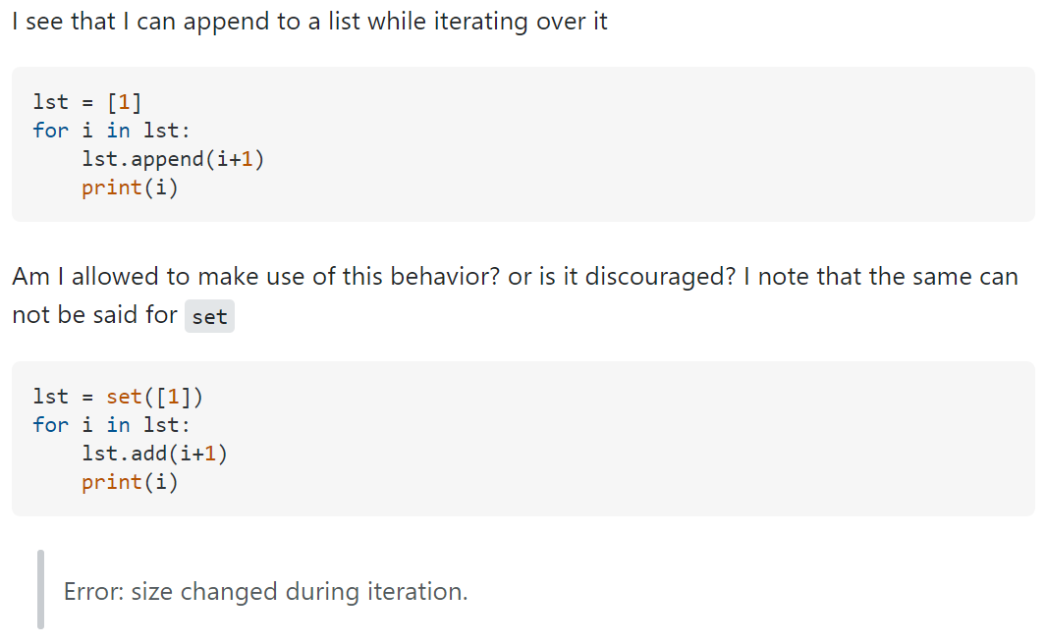
RQ1:Performance
Problem body :
Title :
Ground truth: Is it correct to append to a list while iterating over it ?
BM25: Iterating over partitions in Python
NMT: How to append to a list ?
Hybrid-DeepCom: Appending a list to a list comprehension in python
Transformer: Python list comprehension
BART: Python list append ( )
Code2Que: How to append to a list in python ?
SOTitle: Is it discouraged to append to a list while iterating over it ?
Notes:
To more visually demonstrate the advantages of our approach, the slides on this page shows the titles generated by SOTitle and baselines for a Java question post. In this example, we can find that the title generated by BM25 is not relevant to the question post. The titles generated by NMT, Hybrid-DeepCom. Transformer and BART cannot correctly express the core idea of the question post. CodeQue fails to capture the details of the problem. However, the title generated by our approach can accurately and fluently express the key information in this post.

Slide 12
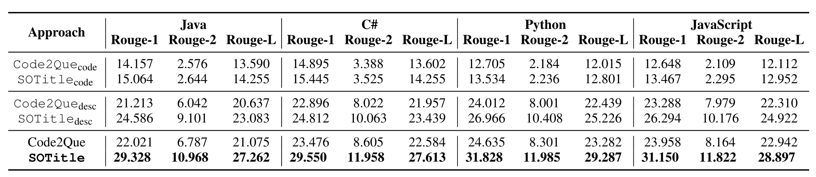
RQ2:Different input modalities
Summary: Problem description can provide more valuable information than the code snippet for post title generation. Moreover, considering two modalities together can improve the performance of SOTitle and Code2Que.
Notes:
In this RQ, we aim to investigate the contribution of different input modalities to the performance of SOTitle and CodeQue.
This table shows the performance of SOTitle and CodeQue with different combinations of input modes.
Here CodeQue code can denote the performance of CodeQue's original study.
we use different subscripts to distinguish different control approaches.
The subscript code means that the corresponding control method uses only code snippets as input mode.
The subscript desc means that the corresponding control method uses only problem descriptions as input mode.
From the table we can see that using both code snippets and problem descriptions as input has better performance than when using one modality alone as input.
This shows that the information from the code snippet and the problem description is complimentary and both two modalities should be considered for post title generation.

Slide 13
RQ3:Human study
Problem Description:
Assuming I have a column called df.Text which contains text (more that 1 sentence) and I want to use polyglot Detector to detect the language and store the value in a new column df['Text-Lang'] how do I ensure I also capture the other details like code and confidence …
Code Snippet：
testEng ="This is English"
lang = Detector(testEng)
print(lang.language)
…
Title 1: How to detect the language and store the value in a pandas dataframe ?
Title 2: Polyglot Detector Detector Detector Detector
Q1-1: What is the score of Title 1 ?
B. GOOD. C. BORDERLINE. D. BAD.
Q2-1: What is the score of Title 2 ?
A. EXCELLENT. B. GOOD. C. BORDERLINE.
A. EXCELLENT.
D. BAD.
Q2-1: What do you think of Title 1 ? (multiple choices)
A. Relevance GOOD. B. Conciseness GOOD. C. Expressiveness GOOD.
Q2-2: What do you think of Title 2 ? (multiple choices)
A. Relevance BAD. B. Conciseness BAD. C. Expressiveness BAD.
Notes:
In our human study, we randomly select 50 question posts for each programming language. For each post, two titles are generated by CodeQue and SOTitle respectively. Each question post was evaluated separately by six master students during the survey.
These Masters students have more than five years of project development experience and are familiar with Stack Overflow usage.
We randomly ordered the selected question posts, and the students did not know which title was generated by our approach.
Second, we asked the hired students to give reasons to support their scores. To simplify this process, we only surveyed the advantages of the generated titles which are scored as ``Excellent" or ``Good" and the disadvantages of the generated titles which are scored as ``Borderline" or ``Bad".
The reasons are summarized from three perspectives.
• Relevance. The generated title can capture the main idea of the question post with correct and sufficient detail.
• Conciseness. The generated title does not contain unnecessary information and uses a short sentence to show the main idea of the post.
• Expressiveness. the generated title can be clearly described.

Slide 14
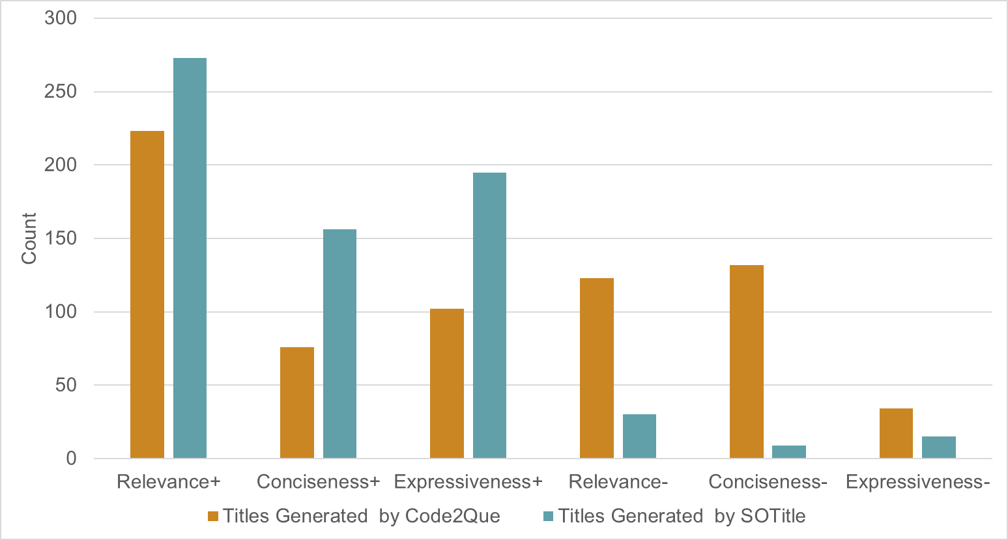
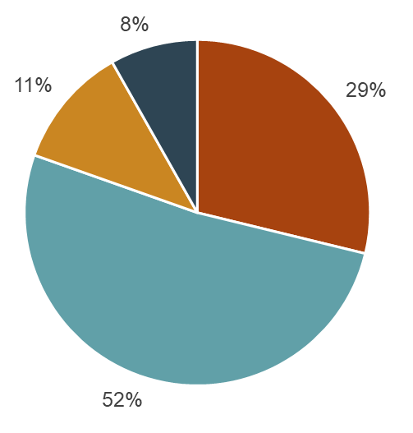
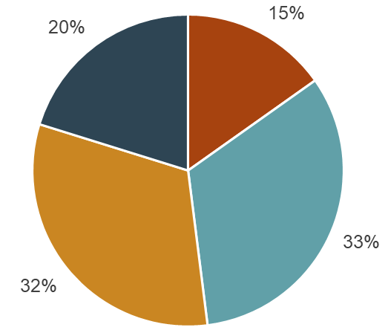
RQ3:Human study
2
1
0
-1
Titles Generated by Code2Que
Titles Generated by SOTitle
Summary: SOTitle can generate higher-quality titles than the baseline Code2Que via human study.
Notes:
This slice shows the statistical results of 200 feedback comments, each containing four perspectives: Overall Rating, Relevance, Conciseness, and Expressiveness.
As the pie chart on the left shows, the left and right subfigures show the votes for the titles generated by CodeQue and the titles generated by SOTitle, respectively. We notice that 81% of the human ratings for the titles generated by SOTitle are not less than 1, which means they are considered to have good quality and can be used as titles without major modifications.
Moreover, in the bar chart on the right, the distribution of human comments shows that the titles generated by SOTitle received more positive comments after compared to the titles generated by CodeQue in terms of three perspectives (i.e., Relevance, Conciseness, and Expressiveness).
Therefore, our proposed approach can help to improve the post title quality.

Slide 15
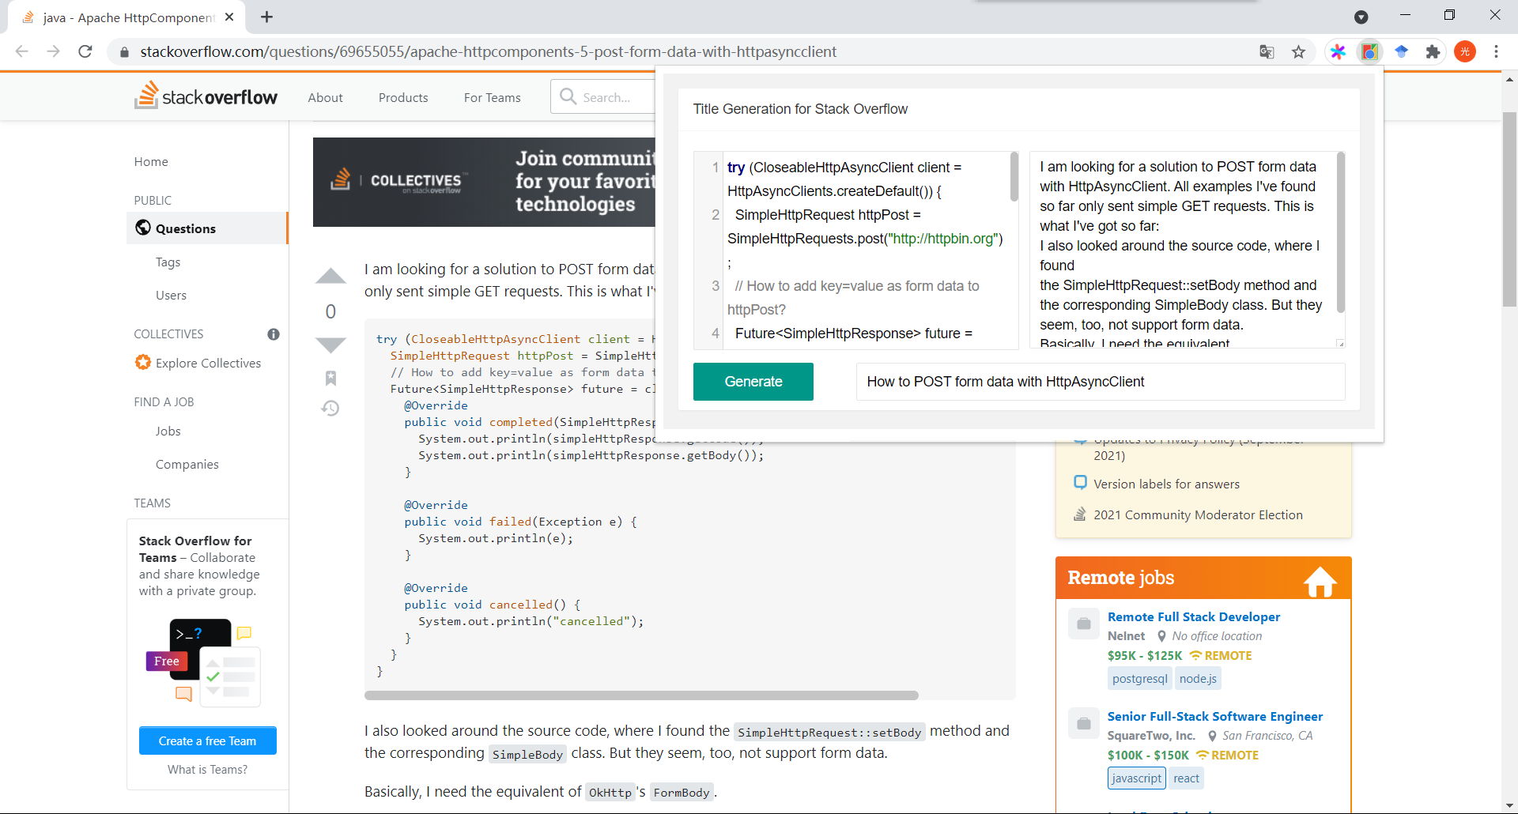
Tool
1
2
3
4
Notes:
To facilitate the use of our proposed approach, we developed a browser plug-in based on our constructed model. This slice shows the screenshot of our developed browser plug-in.
When using this plug-in, the developer can first copy the code snippet in 1 and the detailed problem description in 2. Then the developer can click the generate button in 3. Finally, the generated title can be displayed in 4.

Slide 16
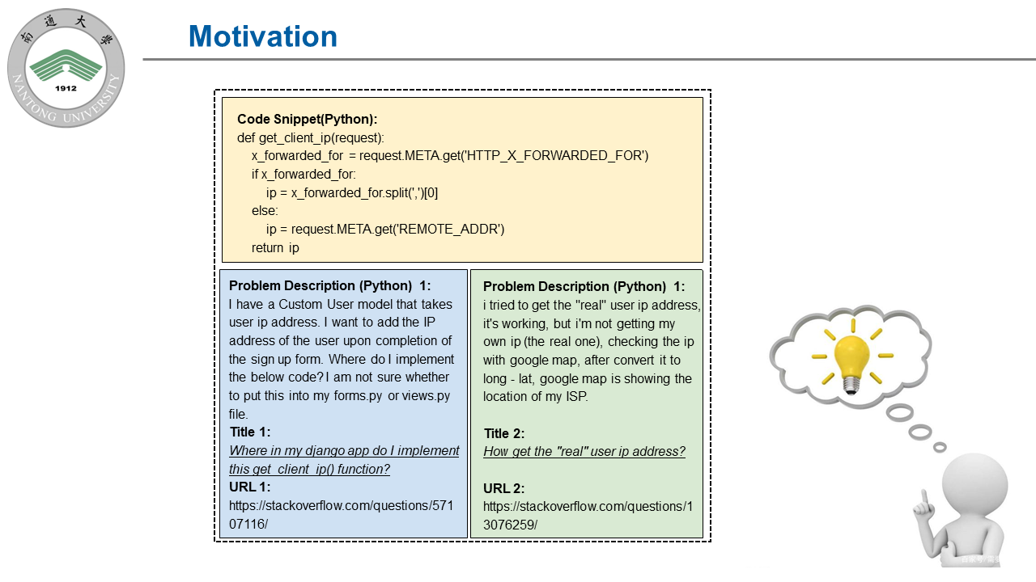
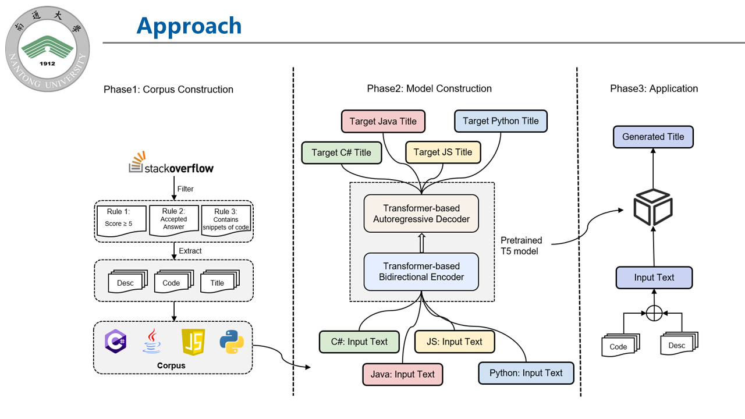
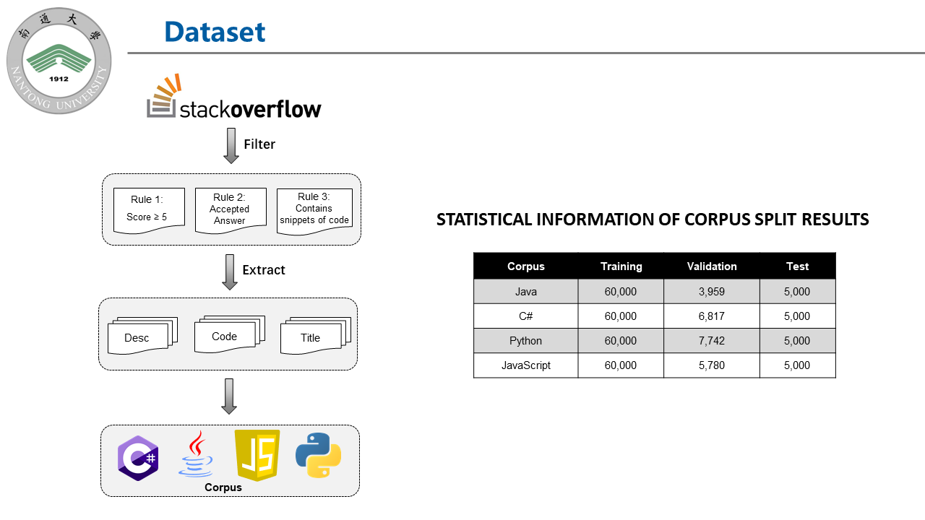
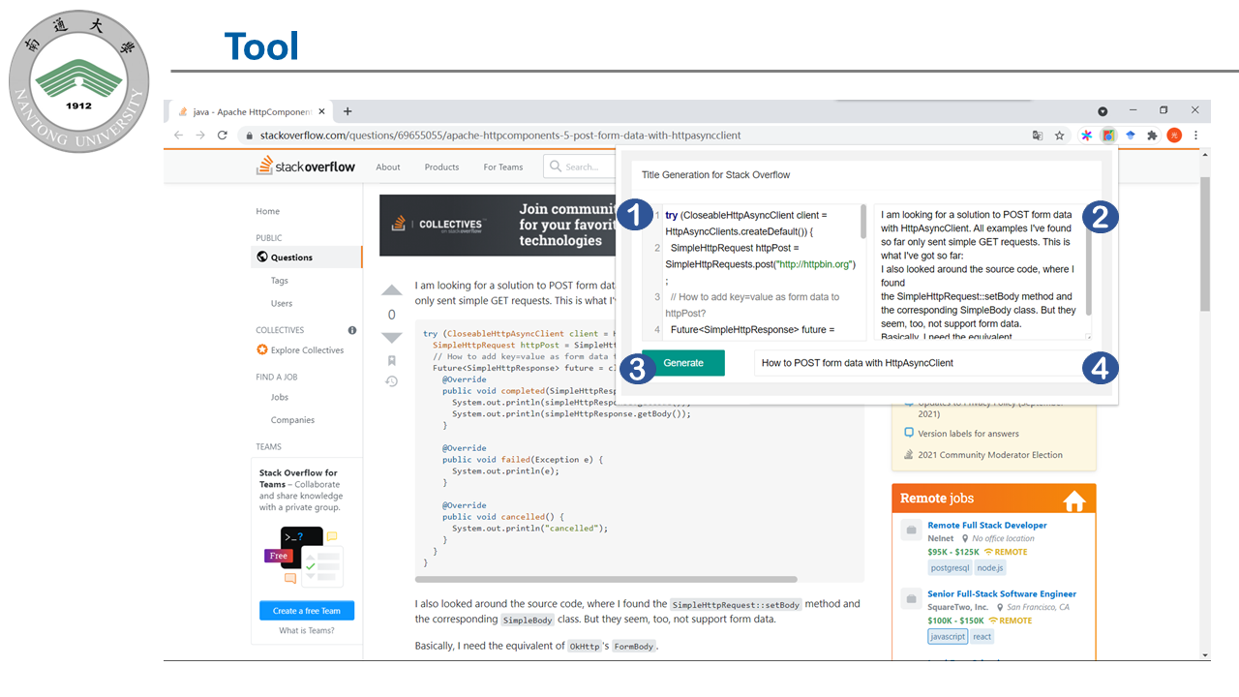
Summary
https://github.com/NTDXYG/SOTitle
Thanks for Your Listening !
Notes:
At the end of this presentation, I will summarize our work. Since previous studies ignored the useful information contained in the problem post descriptions when conducting the question post generation studies, we propose an approach SOTitle for automatic post title generation by leveraging the code snippets and the problem description in the question post (i.e., the multi-modal input). To verify the effectiveness of SOTitle, we construct a large-scale high-quality corpus from Stack Overflow, which includes 1,168,257 high-quality question posts for four popular programming languages. Experimental results show that SOTitle can significantly outperform six state-of-the-art baselines in both automatic evaluation and human evaluation. To facilitate the use of our proposed approach, we developed a browser plug-in based on our constructed model. To encourage follow-up studies, we make our corpus and approach publicly available.
In the future, we first aim to further improve the performance of SOTitle by considering more advanced deep learning methods (such as graph neural networks for code snippets). We second aim to combine SOTitle with other kinds of approaches (such as information retrieval-based approaches and template-based approaches)
Thanks for your listening.

